Slide 1
Computer Graphics: Rendering
Lecture 8: Raytracing - advanced
Kartic Subr

Slide 2


Slide 3
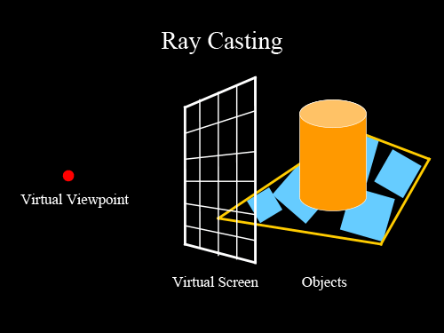
Recap

Slide 4
Recap
for each pixel p
trace ray
shade hit point

Slide 5


Shading
diffuse reflection
ambient light
specular reflection
final shading

Slide 6
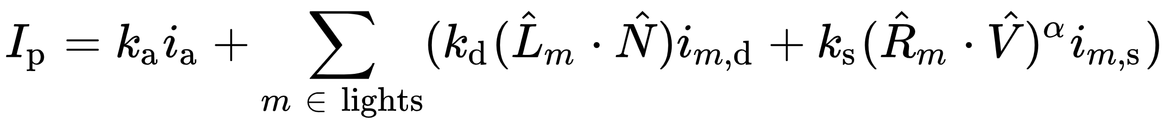
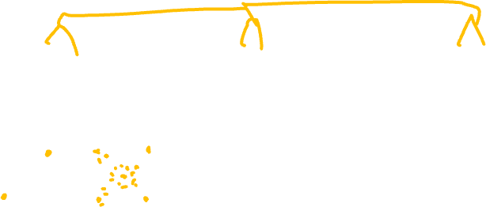
Phong shading
material property
ambient
diffuse
specular
light property
R is the mirror reflection direction
source:wikipedia

Slide 7
How to deal with texture?

Slide 8
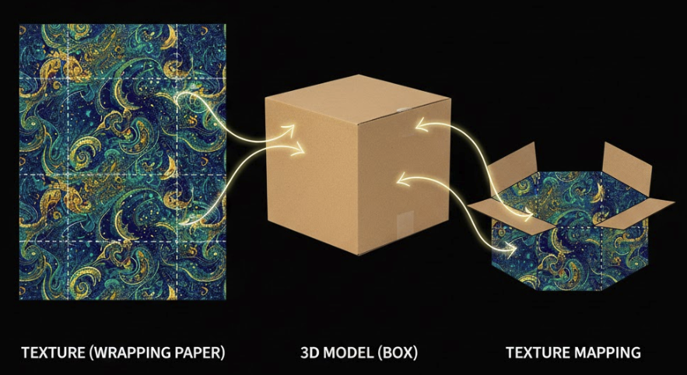
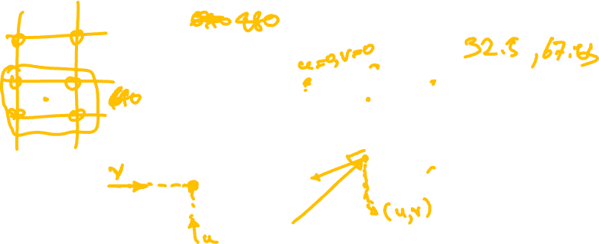
Texture mapping

Slide 9
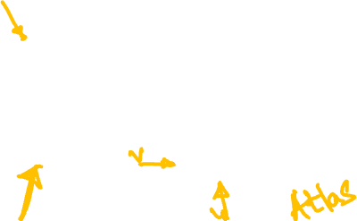

Slide 10

Mapping from 3D to 2D
World/object space
texture space
mapping
texture coordinates

Slide 11
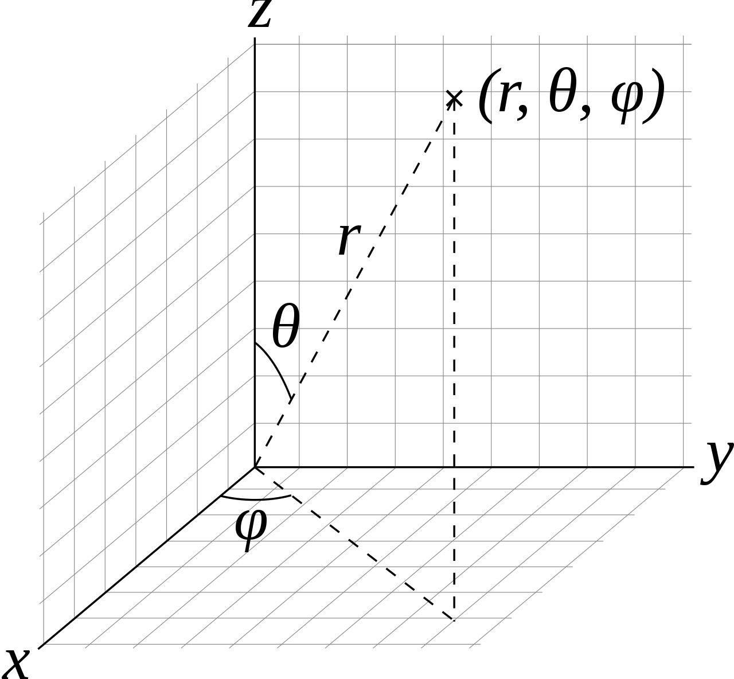
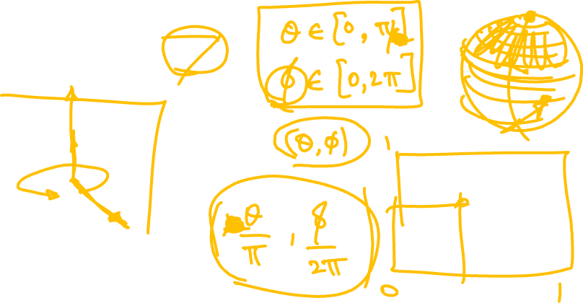
Texture coordinates on a sphere

Slide 12
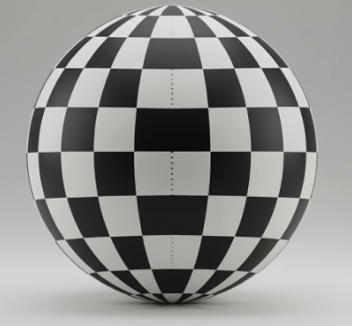
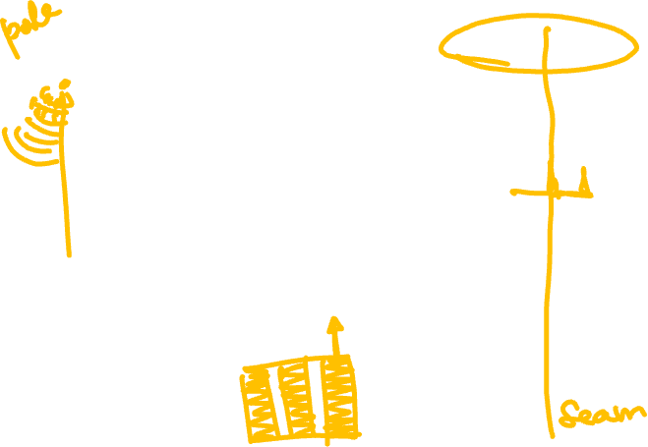
Texture coordinates on a sphere
If you’d like to learn more …

Slide 13
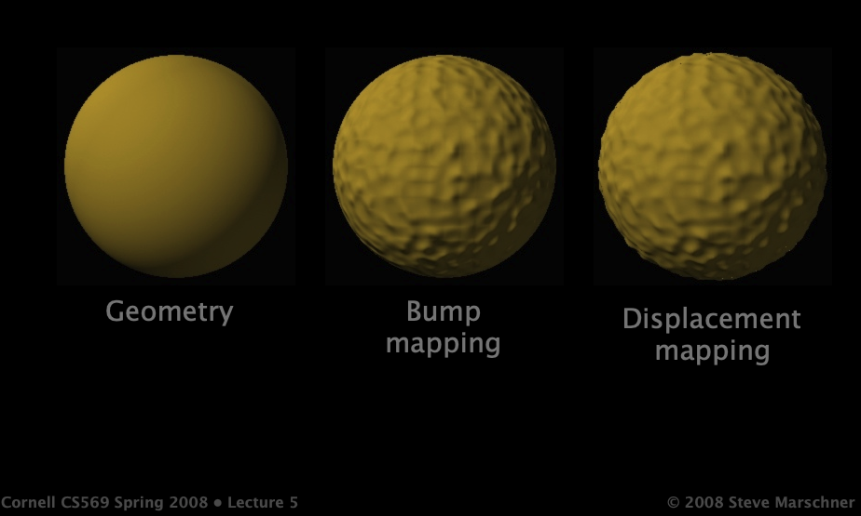
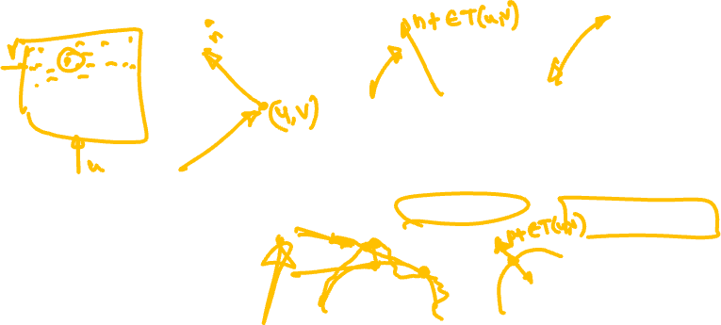
Can use textures for modifying geometry…

Slide 14

Problems
How to generate maps?
Finite resolution
Artifacts
More later!
http://www.cemyuksel.com/courses/conferences/siggraph2017-rethinking_texture_mapping/rethinking_texture_mapping_course_notes.pdf

Slide 15
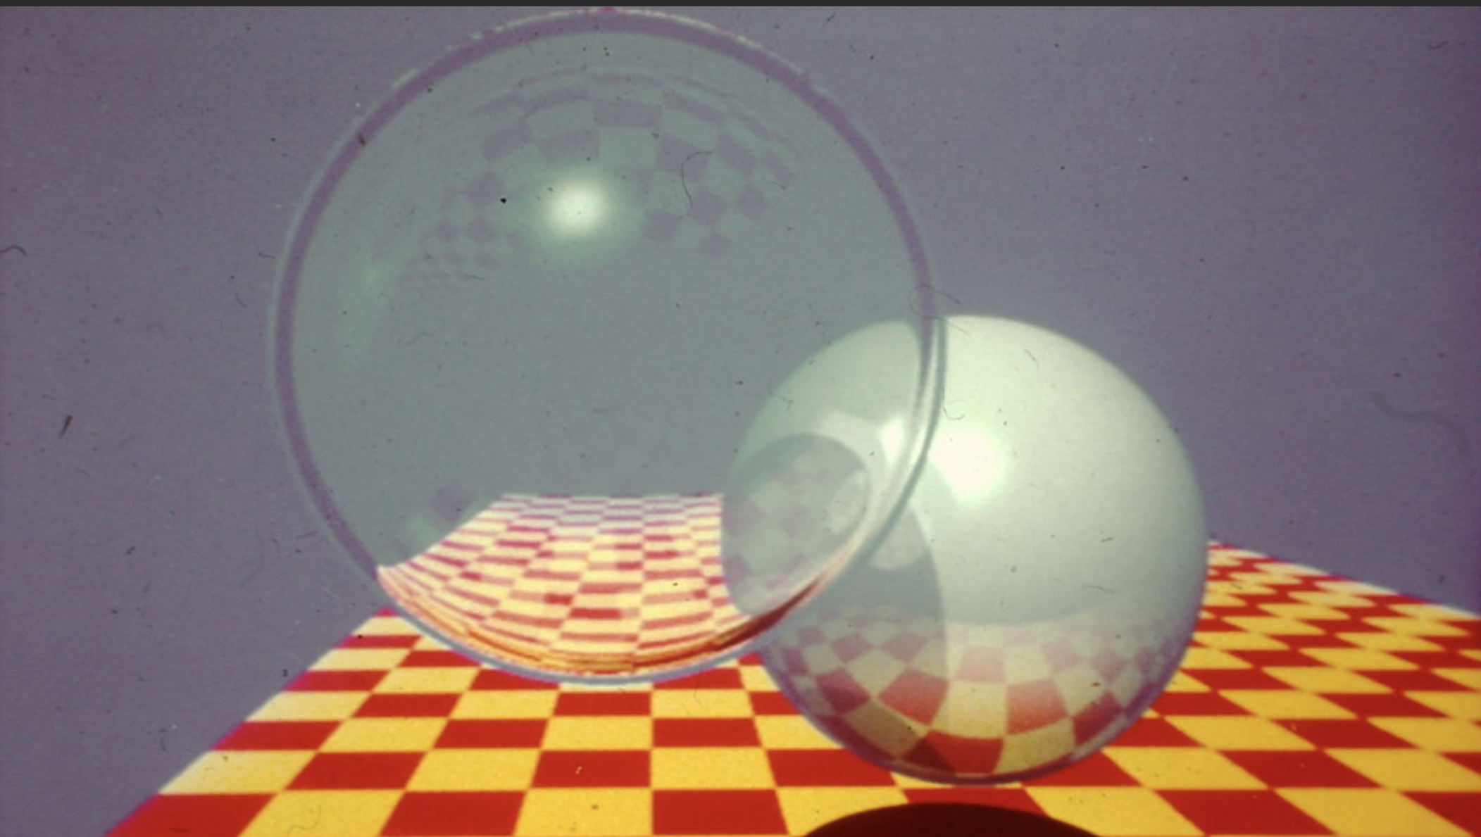
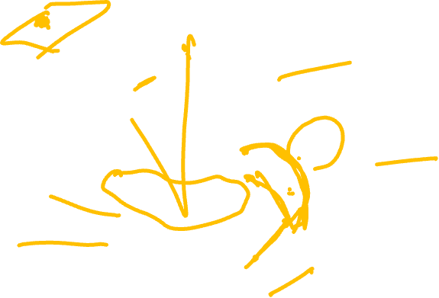
What’s wrong with this image?

Slide 16
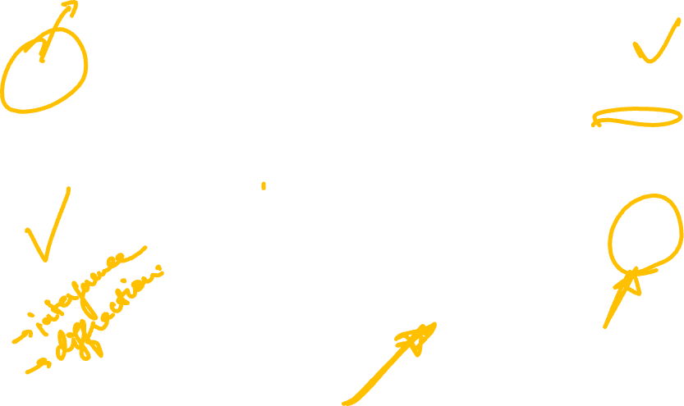
Does not have any blur!

Slide 17
What causes blur?

Slide 18

A step function (edge)
pixel value
255
0
image

Slide 19
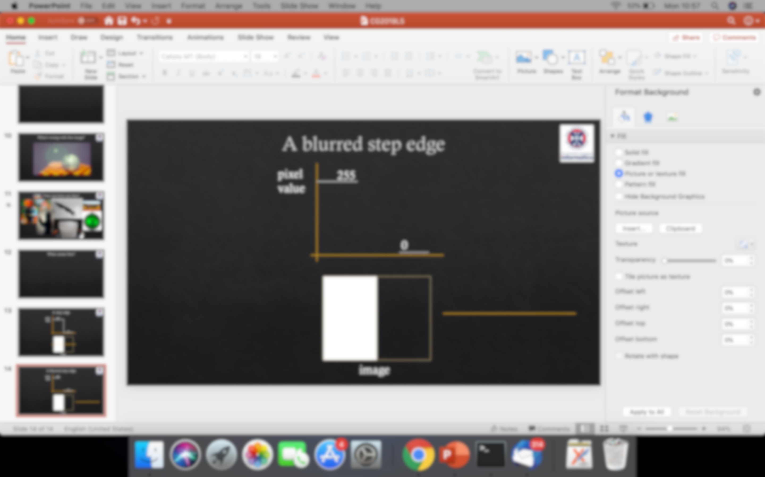




A blurred step function
pixel value
255
0
image

Slide 20




Fundamental operation?
255
255
?
0
0

Slide 21
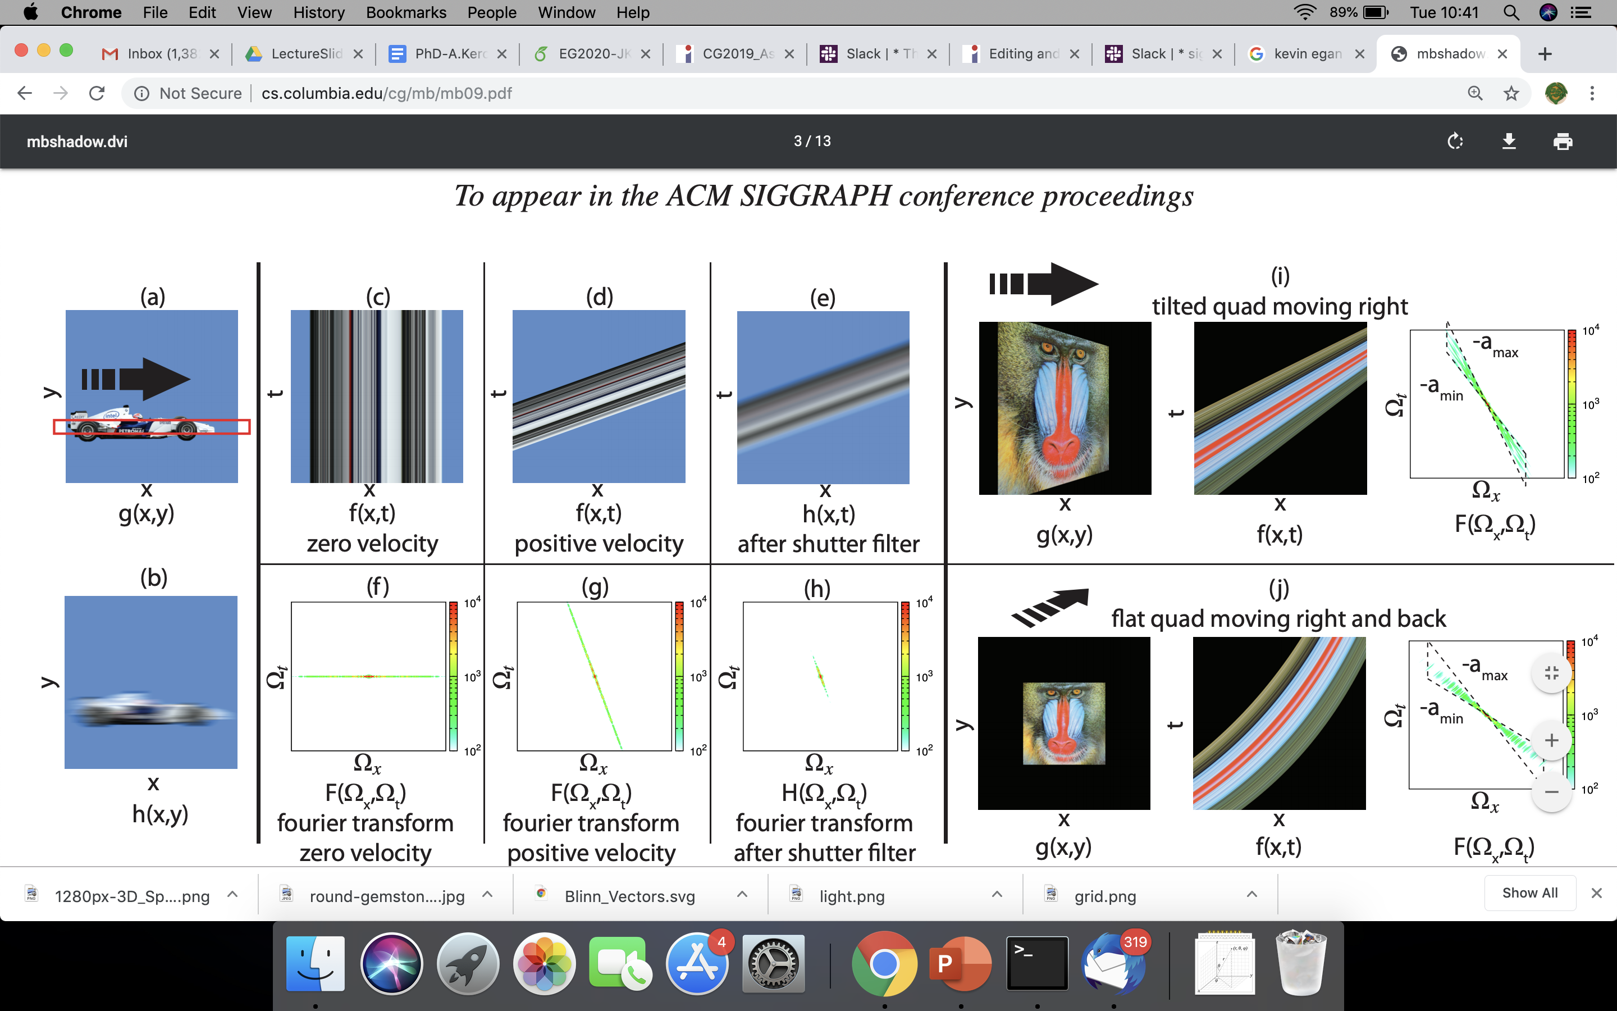

Example: photo of a car
slice in y
f(x)

Slide 22
Example: motion blur

Slide 23
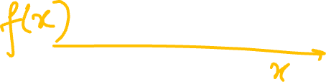
Example: slice is a 1D function
f(x)
space (x)

Slide 24

Example: add time as second dimension
time (t)
space (x)

Slide 25
Example: stationary car
time (t)
space (x)

Slide 26
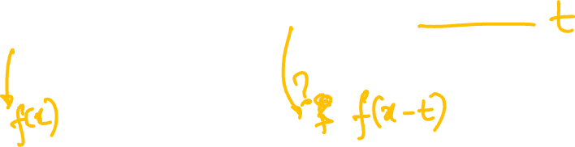
Example: car moving to the right
time (t)
space (x)

Slide 27
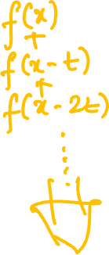
Example: sum of shifted positions
space (x)

Slide 28

Example: motion blur
space (x)

Slide 29

Sums of shifted functions!
f(x)
255
+
f(x-t₁)
0
+
f(x-t₂)
…

Slide 30
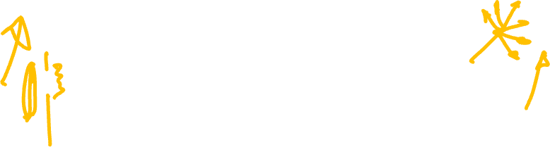
Can you spot the “shifted sums” in each case?

Slide 31
Soft shadow due to area light

Slide 32
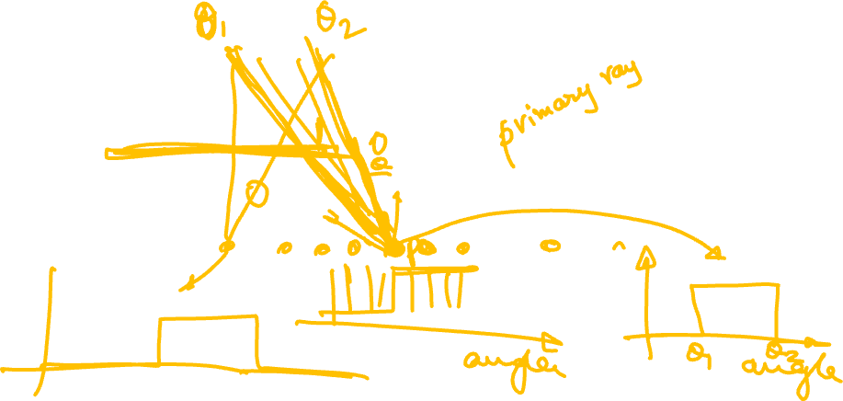
Example: Area light
light

Slide 33
Example: Area light
point light

Slide 34
Area light: integrate over angle
light

Slide 35
Sums of shifted functions!
f(x)
255
+
f(x-t₁)
0
+
f(x-t₂)
…

Slide 36
Sums of weighted, shifted functions!

Slide 37
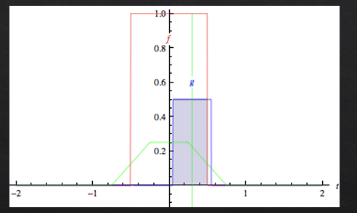
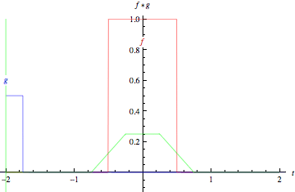
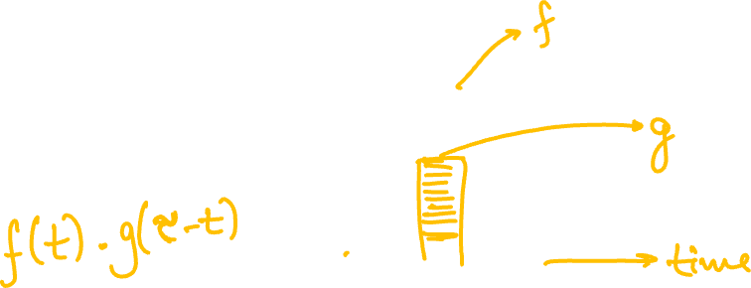
Sums of weighted, shifted functions!
wikipedia

Slide 38
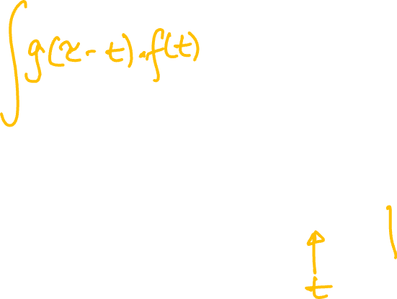
Sums of weighted, shifted functions!
wikipedia

Slide 39
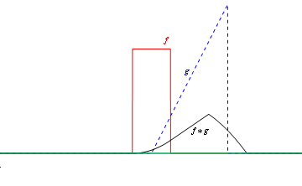
Sums of weighted, shifted functions!

Slide 40
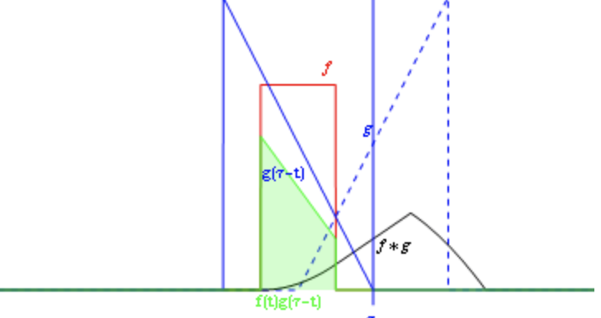
1D convolution

Slide 41
Sums of weighted, shifted functions!

Slide 42
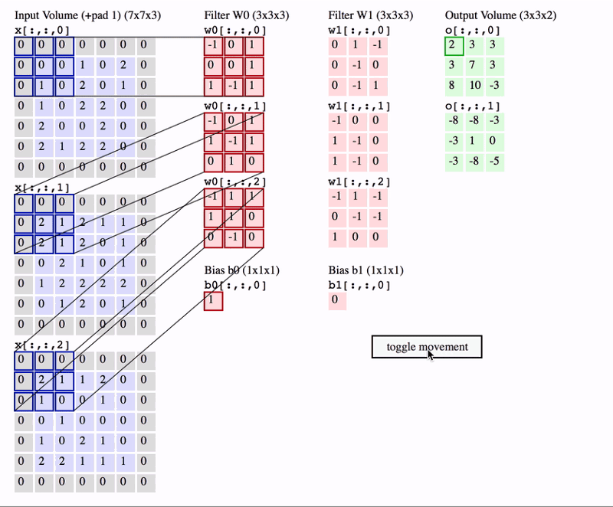
2D convolution
https://www.freecodecamp.org/news/an-intuitive-guide-to-convolutional-neural-networks-260c2de0a050/

Slide 43
Blurring due to integrals in rendering
area lights
camera lens
camera shutter, exposure time
wavelength (colour spectrum)
gloss (reflectance)
translucent objects

